Slide 1
Norwegian Media Trends 2022
02.05.21
Knut-Arne Futsæter, Kantar

Slide 2
Executive Summary: The Norwegian news media have strengthened their position during the corona pandemic
Long-term media trends
Decreased daily use of traditional media
Increased daily use of digital media and decline in daily reach for paper magazines and the paper editions of the newspapers
The digital transformation accelerated during the corona pandemic
The Norwegian news media strengthened their position during the corona pandemic
Newspapers where the first mover of the digital transformation
The Norwegian newspaper industry was among the first in the world to start the digital transformation
The digital tipping point for newspaper came in 2014 (Digital Tipping Point), when for the first time more people read newspapers digitally than on paper
The digital transformation varies a lot between papers
The magazine industry has just started the digital transformation
The magazines Se & Hør and KK have established digital editions that actually have more readers than the paper editions.
Linear TV decreases while streaming increases
From 2020, more people are viewing streaming than linear TV. The total reach for TV and video has never been as high as in 2021.
Time spent on live TV declines, while time spent on BVOD is increasing
Netflix, YouTube & HBO declines, while BVOD increases
More and more people have access to SVOD and the usage increases
Podcasts increase the consumption of total audio
The Norwegian news media have strengthened their position during the corona pandemic
The three largest media companies in Norway have a total digital daily reach of 78%
The three media houses have a higher reach than Facebook
Notes:
The agenda looks as follows.

Slide 3
Decreased daily use of traditional media
Daily reach 1960 – 2021
TV
Radio
Newspapers
Percent
Magazines
Kilde: Daglig oppslutning om papiravis og nettaviser 1961-2021. Det har vært metodiske endringer de siste årene, og mer info om dette ligger her:
Data fra Forbruker & Media fra 1994. Flerkanalsamfunnet (Lundby & Futsæter, 1993). Fragmentering av medielandskapet og oppsplitting av publikum (Futsæter 1998).
Nettavisene gjelder MBLs nettaviser som også utgir papiraviser og som blir målt i F&M, og fra 2020 inngår også rene digitale aviser som E24 og Nettavisen.
Fra 2018 er alle digitaltallene kalibrert i forhold til de offisielle onlinemålingene. Fra 2018 inngår også eAviser. eAviser inngår i «Totalt» og i «Nettaviser».

Slide 4
Increased daily use of digital media
Daily reach 1997 - 2021
Percent
Source: Kantar Consumer & Media. CATI

Slide 5
The Norwegian newspaper industry was among the first in the world to start the digital transformation
2014
Daily reach (percent)
Digital
Tipping Point
Kilde: Daglig oppslutning om papiravis og nettaviser 1961-2021. Det har vært metodiske endringer de siste årene, og mer info om dette ligger her:
Data fra Forbruker & Media fra 1994. Flerkanalsamfunnet (Lundby & Futsæter, 1993). Fragmentering av medielandskapet og oppsplitting av publikum (Futsæter 1998).
Nettavisene gjelder MBLs nettaviser som også utgir papiraviser og som blir målt i F&M, og fra 2020 inngår også rene digitale aviser som E24 og Nettavisen.
Fra 2018 er alle digitaltallene kalibrert i forhold til de offisielle onlinemålingene. Fra 2018 inngår også eAviser. eAviser inngår i «Totalt» og i «Nettaviser».

Slide 6
The digital transformation varies a lot between papers
15,3
Digital index = Digital daily reach
Readership paper (AIR)
1,4
3,0
2,1
1,1
0,5
0,4
Source: Kantar Consumer & Media. Readership figures are AIR.
Notes:
With 83.000 paper readers and as many as 1.268.000 digital readers, Dagbladet has come furthest in the digital transformation. It gives a digital index of 15,3. With 271.000 readers on paper, Aftenposten is Norway's largest printed newspaper. Aftenposten has 386.000 digital readers and it gives an index of 1,4. Several national niche newspapers and the smallest local newspapers have more readers on paper than digitally.

Slide 7
The digital transformation accelerated during
the corona pandemic
Source: Kantar Consumer & Media
Notes:
The corona pandemic has accelerated the digital transformation. In 2021, as many as 74% read at least one digital newspaper daily. The digital growth is due to the fact that reading newspapers on mobile increased from 55% in 2019 to 64% in 2021. Overall, as many as 83% read at least one newspaper daily.

Slide 8
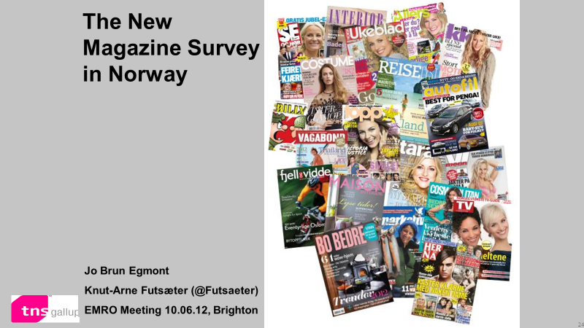
Decline in daily reach for paper magazines
Percent
Source: Kantar Consumer & Media.
Notes:
When it comes to magazines, there has been a decline in daily reach for magazines since we started to measure magazines in 2012, but fairly stable development in recent years.
The magazine industry started the digital transformation much later than a newspaper. Only four digital magazine titles are measured, and as of today it does not make sense to report total digital figures for magazines.

Slide 9
The magazine industry has just started the digital transformation, but ….
Number of readers in thousand
Digital
Tipping Point
Digital
Tipping Point
Source: Kantar Consumer & Media
Notes:
However, two of the magazines have established digital editions that actually have more readers than the paper editions, and thus they have passed the digital tipping point in 2021. Furthermore, we see that there is little duplicated reach between paper and digital so that the total reach is very high.

Slide 10
Linear TV decreases while streaming increases
2020
Daily reach (percent)
Source: Kantar Consumer & Media. CATI
Notes:
Figures from C&M show a decrease in daily reach for TV from 2012 to 2021, increased reach for streaming and total reach for TV and streaming is 94% in 2021. From 2020, more people are viewing streaming than linear TV.
However, the total reach for TV and video has never been as high as in 2021. The saying “TV isn’t dead – It’s just having babies” was introduced at ASI in 2015. The COVID crises has accelerate the digital transformation for all media, and in 2022 people all over the world are watching live TV and streaming services more than ever.
TV er fra F&M CATI for alle år. Strømming: 2012-2020 er CATI og fra MGI fra 2021. TV & Video er fra MGI 2017-2021

Slide 11
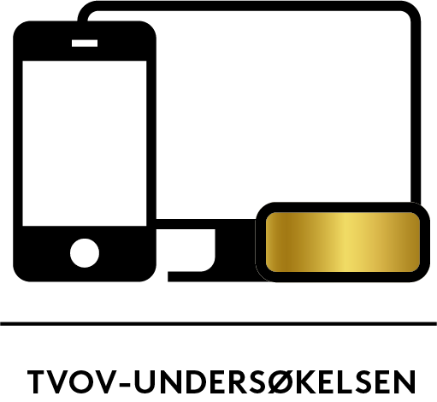
Time spent on live TV declines, while time spent on BVOD
is increasing
Average daily minutes
Source: Kantar TVOV (Two panels, with multiple technologies, census data and data integration).
BVOD: NRK, TV 2, DNN and NENT
Notes:
Figures from the official TVOV measurement show that live TV, broadcast and broadcast video on demand (BVOD), is declining. However, BVOD is increasing and thereby reducing the decline for live TV overall.
People in 2022 are using more time on BVOD than PVR. This confirms how important it is for the TV companies to develop their own user-friendly streaming services with popular content.

Slide 12
Netflix, YouTube & HBO declines, while BVOD increases
Average daily minutes
Source: Kantar TVOV (Two panels, with multiple technologies, census data and data integration).
BVOD: NRK, TV 2, DNN and NENT
Notes:
Again, the blue line shows the increase for the broadcasters video on the demand services from NRK, TV 2, NENT and DNN. We are also measuring some other streaming services in the TVOV measurement. Netflix, YouTube and HBO had in 2018 a total viewing time of 29 minutes which increased to 39 minutes in 2020, but since then they have experienced a decline.

Slide 13
More and more people have access to SVOD
Source: Kantar Consumer & Media. TGI (CAWI)

Slide 14
More subscribers (SVOD) and high daily use
Subscription of SVOD
Daily reach of streaming
Percent
Percent
Source: Kantar Consumer & Media. TGI (CAWI). 1Q 2022
Notes:
Survey measurements are still the most suitable methods for measuring all sort streaming.
YouTube has the highest daily reach, followed by Netflix and NRK TV. Then comes a total of 15 services that have more than 1% daily reach.

Slide 15
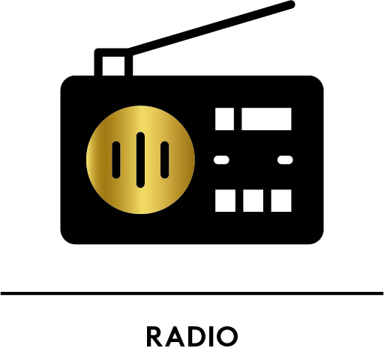
Decline in listening after the digitalisation in 2017
Source: Kantar Consumer & Media. CATI
Notes:
The switch off the national FM radio had an immediate negative effect on the listener figures. The daily reach for radio and the national channels was reduced from 2017.
The local radios, which got the FM band for themselves, got a temporary growth - but have from 2018 had a systematic decline.
Færre målte lokalradio i 2017. Flere større lokal-radioer fra Bauer og P4 Gruppen ble kun riksdekkende.

Slide 16
Podcasts increase the consumption of total audio
Daily reach (percent)
Source: Kantar Consumer & Media. CATI
Notes:
However, podcasts have in recent years increase the total audio consumption. In 1Q 2020 66% are listening to radio or podcasts daily.

Slide 17
The Norwegian media strengthened their position during the corona pandemic
Daily reach (percent)
Source: Kantar Consumer & Media.
NRK (radio, TV, online), TV 2 (TV & online), VG (paper & online), Dagbladet (paper & online).
Notes:
Indeed, traditional surveys provide extremely useful and important insights for the media, public authorities and the general public. Analyzes from C&M documented that Norwegian media strengthened their position during the corona pandemic, the public broadcaster NRK has a total daily reach of 75%. Then comes the TV channels and the website of TV 2 with 54%, the newspaper VG 45% and Dagbladet with 28%.

Slide 18
The three largest media companies in Norway have a total digital daily reach of 78%
Schibsted
62%
Exclusive reach
Schibsted
895.309
Amedia 40%
Double reach
Sch. & Amedia
559.771
Exclusive reach
Amedia
365.458
Triple reach
655.815
Schibsted, Aller or Amedia:
78%
Double reach
Sch. & Aller
532.842
Double reach
Amedia & Aller
148.810
Exclusive reach
Aller Media
175.578
Aller Media
35%
Source: Kantar Consumer & Media TGI

Slide 19
The three media houses have a higher reach than Facebook
Source: Kantar Consumer & Media TGI
Notes:
When we take into account the printed editions of the media houses, the reach grows to 88%. Although Facebook is by far the largest media in Norway, the three media houses have greater reach when they merge.

