Slide 1
The new online measurement in Norway
Brno, Czech Republic 29.05.18
Knut-Arne Futsæter, Kantar Media
Bente Håvimb, Mediebedriftene
Notes:
Hello everybody!
We’re here to update you on the online mesurements in Norway, and since we have a busy day and I wanna leave some time for the last speaker, which is also me, we’ll just jump right in.

Slide 2
Agenda
Introduction
The newspaper measurement
The online measurements
Reporting
Some challenges
Future perspectives
Notes:
So, when we were here last year, we had just started working with Kantar and comScore on the new measurements combining print and online. For the first time, we had a joint contract covering all of our titles on all devices. We started preparations already last year, but it wasn’t until January that the contract became effective.
We were enthusiastic about the new opportunies - both to provide upgraded currencies to the market, but also the possibilities of extending the measurements into a larger eco—system.

Slide 3
1. Introduction
Notes:
And wouldn’t it be great if all dreams came true?
More often, it turns out that reaching your goals is about hard work, and today, we’re here to share some behind the scenes stories about our efforts to set up the new online measurement in Norway.
I’ve already spoken to some of you through I-Jic, but for the rest of you, here is a spoiler alert - as of now, we have yet to go public with any of the data from the new online measurements. Meanwhile, two of the former measurements have been shut down, and as you can imagine we’re in a hurry to meet the demands for reporting-tools from different user groups.
Knut-Arne will guide you throught the details, but first I will give you a quick glance at the media industry in Norway as of today.

Slide 4
Usage: High media consumption
Percent
Source: Kantar Media
Notes:
For those of you that were at the PDRF last year, you might recall that we spoke about the historically strong newspaper industry in Norway, and how consumption of digital content has grown rapidly.
At that time, mobile news was on the verge of surpassing the printed newspress, as you can see from the green line approaching the red.

Slide 5
Mobile only larger than print
Percent
Source: Kantar Media
Notes:
…And by the end of 2017 it did, and we reached the magic mark where, for the first time, more people read content on their mobile devices than in paper editions.
At the same time, print keeps loosing ground. In 2005, 85 percent of Norwegians read at least one paper edition daily, while today the number is down to 44 percent.
Every day, 6 out of 10 Norwegians read newspapers online while 45 percent access news on mobile devices. A lot of this consumption happens cross-device and a wide selection of content is distributed on a variety of platforms, in ever more sophisticated ways.
And this is exactely why the new online measurements are so important to us.
On a more practical note, the new approach will give us the opportunity to present readership for each device separately, rather than just total online and mobile exclusively as in this graph.

Slide 6
Revenues: Print decline and digital growth
Source: IRM
Notes:
The digital transformation also affects the media economy.
In 2013, Internet surpassed printet newspapers, and became the largest advertising channel in Norway, and since then the gap between online and print has only increased.
At the same time programmatic trading has introduced people focused bying, leaving the importance of placement secondary. To gain trust and to be able to inform buyers about who their readers are, Norwegian publishers have chosen a measurement solution with the aim of reporting on people rather than cookies.
In addition, data-driven sales has changed the playing field by introducing greater global competition, and Google and Facebook keep increasing their market shares. This year there are estimates of the duopoly holding as much as 1 quarter of the total advertising market in Norway, and yes - total, not only of digital ad spend.

Slide 7
Newspapers print and online: Share of revenues
Source: MBL
Notes:
As revenues from advertising decline, user revenues become more and more important to the publishers. Today, most of the premium publishers in Norway have introduced some sort of paywall, and userdata is their most valuable asset. Not just to generate ad revenues, but also in order to personalize the user experience.

Slide 8
Key objectives for the request for proposal
A common currency for media usage and media planning
The official documentation of media usage in Norway
Linked to a common target group index
More frequently reported with real time delivery for online
Transparent, documented and designed for the market
Independent validation of methods and results
Notes:
So, with that as our backdrop, let’s take a closer look at what we wanted to achieve and how far we have come based on the key objectives from the RFP for the print and online contract.
We wanted a new currency replacing previous measurements and becoming the official documentation of media usage.
In order to link the online measurements to Kantar’s target group index, we would need to keep reporting on daily use. This is also what the Norwegian market traditionally has been accustomed to.
In addition, the measurements should allow for media planning, and all usergroups, meaning publishers, advertisers and agencies should benefit from the output.
At last, we wanted more frequent reports for the online deliveries, and we were looking for a well documented and transparent solution in order to validate methods and to inform the market.
And with that I’ll hand it over to you Knut-Arne, and you will tell us more about how far we´ve come and the challenges we’ve met so far.

Slide 9
2. The newspaper measurement
Notes:
I will start with a short re-cap of the newspaper and online
Measurements.
First the Newspaper readership measurement

Slide 10
Brand First for reporting the total brand footprint
Paper
ePaper
Mobile
Desktop
Tablets
Recall methodologies have their limitations
Combine surveys with passive measurements
Calibration
Notes:
We will measure all platforms in the C&M survey (NRS): Paper editions, ePapers, mobile, desktop and tablets
However, recall methodologies have their limitations when it comes to measuring all types of digital content. So, we have to combine traditional surveys with passive electronic measurements and use data integration to report consumption of digital content in the traditional NRS databases.
Brand First is the best method for reporting figures from all platforms and the total brand footprint.

Slide 11
3. The online measurement
Notes:
The online measurement will be deliver by comScore and was presented at the EMRO in Luzern.

Slide 12
Unified Digital Measurement: UDM
PERSON Measurement
(passive person-centric)
DEVICE Measurement
(site-centric)
PANEL
CENSUS TAGS
Unified Digital Measurement (UDM)
Notes:
The comScore approach combines person-level measurement from desktop and mobile device panels with census data to account for 100% of the use.
Participating companies place tags on all their content – web pages, videos, apps and ads, and these calls are recorded by comScore servers every time content is accessed. The system is able to view these calls on its global panel in addition to measuring the census tag calls.
However, the approach is more complex than that since the unified digital measurement solution also is using other elements such as enumeration survey to define the overlaps and multi-platform definitions to produce MMX MP.

Slide 13
Measuring Norwegian and international online content
Measuring and reporting all devices: Desktop, tablets and mobile.
The comScore’ global methods and standards.
comScore will deliver monthly figures to Kantar and we will calibrate the figures
Validations and calculations of the data are based on the UDM method for monthly data sets.
comScore’s main deliveries to the market is analytic tools such as MMX, MoMX, VMX etc. These tools will be used by the media agencies and advertisers.
Notes:
We will measure both Norwegian and international online content and reporting all devices: Desktop, tablets and mobile.
The comScore online measure in Norway will follow global comScore’ methods and standards.
comScore will deliver monthly figures to Kantar and we will calibrate the figures into C&M (NRS).
Validations and calculations of the data are based on the UDM method for monthly data sets.
comScore’s main deliveries to the market is analytic tools such as MMX, MoMX, VMX etc. These tools will be used by the media agencies and advertisers.

Slide 14
4. Reporting
Notes:
Reporting

Slide 15
Monthly calibration from comScore to C&M (NRS)
Kantar Online (Galileo/Gallup PC) will report daily figures for all platforms.
The publication platform Medieportalen will report daily figures for all platforms monthly. This website will deliver official online figures for all Norwegian media also for TV, radio, newspaper, magazines and online.
For online:
Rankings of daily reach for all platforms
Graphic with demographic profile
Comparison of online sites
Trend analyses
Notes:
We will monthly calibrate the figures from comScore into C&M.
Kantar Online (Galileo/Gallup PC) will report daily figures for all platforms.
The publication platform Medieportalen will report daily figures for all platforms monthly. This website will deliver official online figures for all Norwegian media also for TV, radio, newspaper, magazines and online. For online:
Rankings of daily reach for all platforms
Graphic with demographic profile
Comparison of online sites
Trend analyses

Slide 16
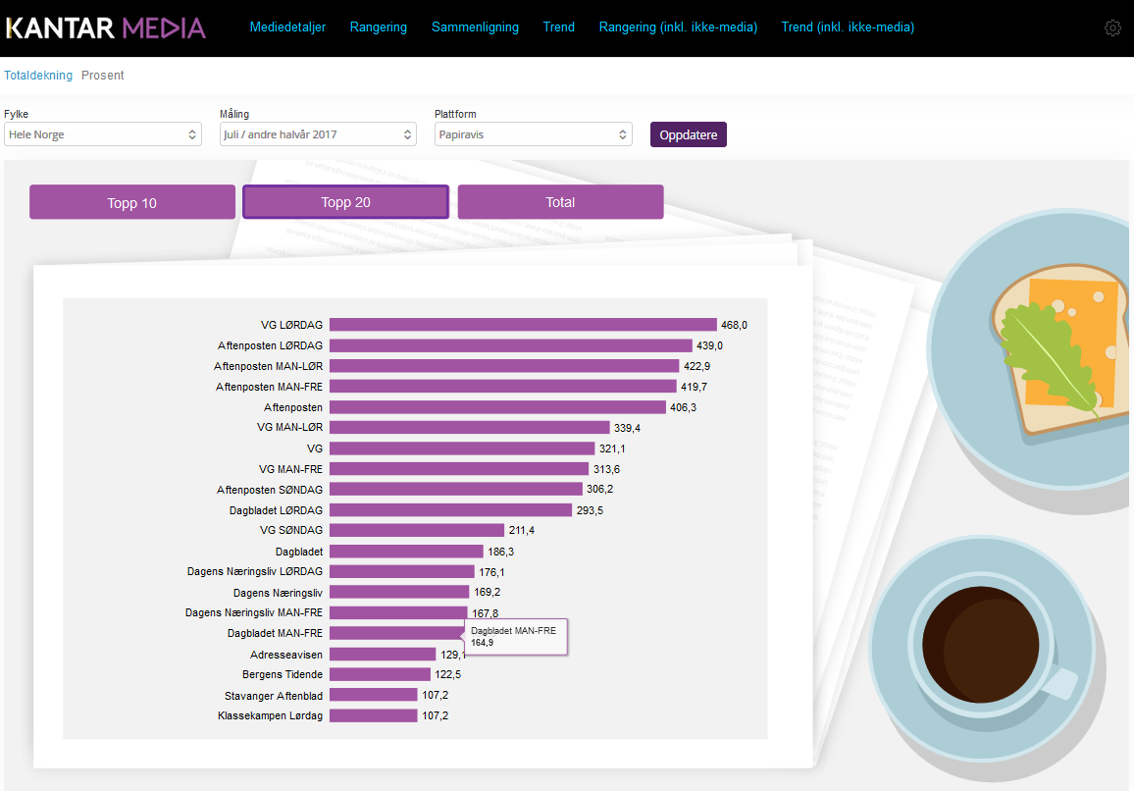
1. Rankings (Medieportalen)
Notes:
This slide from Medieportalen illustrate how we reports the ranking of the newspapers and we will give rankings of daily reach for all platforms.

Slide 17
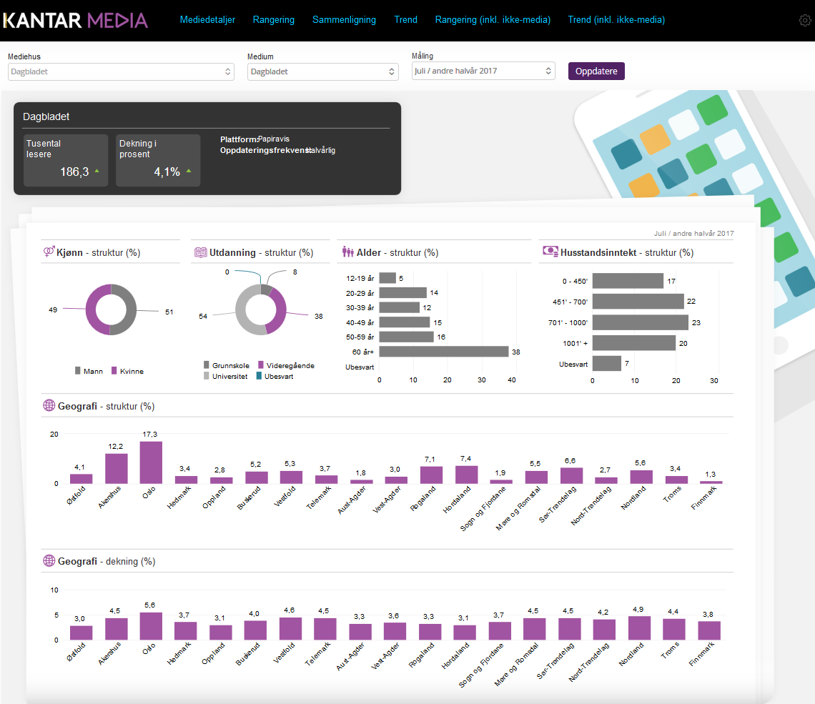
2. Graphic with demographic profiles (Medieportalen)
Notes:
And this slide from MediePortalen illustrate how can analyse the profile of the users. It will be demographic and geographic figures and graphic.

Slide 18
5. Some challenges
Notes:
Some challenges

Slide 19
Some challenges
comScore’s UDM method is developed for mainly reporting monthly audience measurement figures, - not for daily reach (ADV). However, the Norwegian publishers are used to daily averages as their currency.
Technical and practical challenges:
There are still many websites that have not fully tagged all their content. This is imperative for the ADV calculations.
Nedoms (Non-essential domains) are URLs (pop-ups/pop-unders) that should not be included in the reportable entity. These needs to be confirmed with the clients and cleaned from the measured data.
Microsoft Defender AV dropped comScore of their whitelist in error, resulting in a loss of 1000 panel-members. Panel build-up is in progress and expected to reach normal levels in June.
The data inputs to the Average Daily Visitors (ADV) calculation still need to be cleaned up before the measure can play the role of the currency.
Notes:
comScore’s UDM method is developed for mainly
reporting monthly audience measurement figures, - not
for daily reach (ADV).
However, the Norwegian
publishers are used to daily averages as their currency.
Technical and practical challenges:
There are still many websites that have not fully tagged all their content. This is imperative for the ADV calculations.
Nedoms (Non-essential domains) are URLs (pop-ups/pop-unders) that should not be included in the reportable entity. These needs to be confirmed with the clients and cleaned from the measured data.
Microsoft Defender AV dropped comScore of their whitelist in error, resulting in a loss of 1000 panel-members. Panel build-up is in progress and expected to reach normal levels in June.
The data inputs to the Average Daily Visitors (ADV)
calculation still need to be cleaned up before the
measure can play the role of the currency.

Slide 20
A temporary solution for desktop figures
The media, media agencies, advertisers and the public are waiting to see the new online figures.
The census data gives stable, credible and transparent figures.
We have many analysis that shows collerations between census data and audience data (ref. EMRO 2015).
The ratios for UDM (ADV) and census data on daily basis are between 1.0 and 1.2 for the largest sites who have valid UDM (ADV) figures.
A proposal for a solution for the May data:
Use UDM ADV for the largest sites with valid data (ref. tagging & Nedoms).
CookieToPerson (C2P) for homogeneous groups of sites.
Notes:
A temporary solution for desktop figures
The media, media agencies, advertisers and the public are waiting to see the new online figures.
The census data gives stable, credible and transparent figures. We have many analysis that shows collerations between census data and audience data – perhaps you remember EMRO in Stockholm 2015...
The ratios for UDM (ADV) and census data on daily basis are between 1.0 and 1.2 for the largest sites who have valid UDM (ADV) figures.
A proposal for a solution for the May data:
Use UDM ADV for the largest sites with valid data (ref. tagging & Nedoms).
CookieToPerson (C2P) for homogeneous groups of sites.

Slide 21
Reporting stable and credible figures for 20 years from C&M:
Daily reach for VG: Print, online and mobile
Numbers in thousands
Source: Kantar Media 2017.
Notes:
We have actually been reporting stable and credible figures for 20 years from C&M. This means that the clients are used to the same old CATI method with pretty stable figures.
I have presented this slide for VGs daily reach for VG total, print, online and mobile several times at EMRO meetings. These media house analyses are very popular among the media directors and are used by the press and in annual financial reports.
So, you can understand the reactions when the media researches bring in new and perhaps lower figures – like we did 2015….

Slide 22
Some other aspect
The media are used to stable, credible and transparent methods and figures.
Measurement methods and figures have to adopt new technological and political decision such as updating of software, cookie deletion and GDRP more rapidly than ever before. These are huge challenges for the media, JIC’s, and research companies.
Mobile and tablets account for more than 60% of the traffic in Norway, and desktop for under 40%.
C2P factors (1,0 - 1,2) for desktop will have minimal effect for the total online reach and the total brand footprint (desktop, tablet, mobile, ePaper, paper) for the newspapers.
The daily reach figures are only used for internal analyses and for ranking of the services. The professional market and media agencies will use the comScore MMX, MoMX etc. for planning and campaign analyses.
Notes:
Some other aspect
The media are used to stable, credible and transparent methods and figures.
Measurement methods and figures have to adopt new technological and political decision such as updating of software, cookie deletion and GDRP more rapidly than ever before. These are huge challenges for the media, JIC’s, and research companies.
Mobile and tablets account for more than 60% of the traffic in Norway, and desktop for under 40%.
C2P factors (1,0 - 1,2) for desktop will have minimal effect for the total online reach and the total brand footprint (desktop, tablet, mobile, ePaper, paper) for the newspapers.
The daily reach figures are only used for internal analyses and for ranking of the services. The professional market and media agencies will use the comScore MMX, MoMX etc. for planning and campaign analyses.

Slide 23
Objectives and expectations
A common currency for media usage and media planning
MMX, MoMX, Kantar Online (Gallup PC)
The official documentation of media usage in Norway
Medieportalen, Kantar Online (Gallup PC)
Linked to a common target group index
Kantar Online (Gallup PC)
More frequently reported with real time delivery for online
Monthly (Medieporten, MMX, Kantar Online)
Transparent, documented and designed for the market
The comScore’ global methods and standards.
Independent validation of methods and results
The comScore’ global methods and standards
Expectations from some publishers
Internal web analytic tool?
Large expensive high quality panel?
Valid profile data for all sites/categories?
Real time delivery of all data?
Notes:
As you can see on the left hand side, the mail objectives
of the RFP are full fined. The media agencies' have got
360 degree data with online use for Norwegian and
foreign media that can be used planning.
However, there are some other expectations from some
of the publishers. For example, what about:
Internal web analytic tool?
Large expensive high quality panels?
Valid profile data for all sites/categories?
Real time delivery of all data?
This is not really part of the contract, so I think it is
something we have to discuss with the publishers and
the JIC. Well, then I would like that Bente tell us about
the future.

Slide 24
6. Future perspectives
Notes:
Knut-Arne just described the core of the contract, and to sum up I would like to say a few words about were we go from here.

Slide 25
COMSCORE
KANTAR
Consumer data
Persons
Devices
Media data
UDM
Currency tools
Profile validation
MMX, MMX MP
VMX
Profile enrichment
Currency tools
Re-contacts
Notes:
As you might have noticed our current solution actually gives us two datasets and two sets of demographics. One represented through the MMX software from comScore, reporting on any website or app used by Norwegains and exposed to the panel. The other based on peoples recollection of brands asked about within consumer and media. The latter approach also connects online readership figures to consumer and media data through the target group index.
As Knut-Arne has described these soloutions covers different user needs, but we still expect some confusion in the market, and it will be important for us to have clear guidelines as to how to use the different data.

Slide 26
Notes:
Because of panel insufficiencies, lack of tagging and investigation of nedoms, we will not be able to publish data from Mai on daily reach, and June data will most likely also be questionnable on an ADV level.
However, we still need to choose wether or not to implement the C2P model on censusdata, or trust that ADV will be approved on the dataset from June. C2P has been rejected before, but for smaller sites depending on censusdata only, it is more likely to be adapted.
And when, and if, these issues are resolved we can get back to our dream, taking the data to the next level…

Slide 27
One common DMP for the Norwegian publishers?
Persons
Devices
UDM
MMX, MMX MP
VMX
One common
DMP
“Media-Norway”
Consumer data
Media data
Currency tools
Notes:
We’ll provide the raw data from the online measurements to the publishers, who in turn could integrate the data into their own systems, covering needs for internal traffic reporting.
On the next level – MMX data for filtering, Media and consumer data for data enrichment and possible login-data could be merged into a unique DMP making data available in new ways.
There has been a lot of talk of a joint login solution among Norwegian publishers, but so far nothing tangible has sprung out of these conversations.
What we do see, however, are publishers pooling their inventory and broadening the scope of their possible allies to provide high quality advertising products to the market.
One example is Schibsted, Polaris (partly owned by Schibsted) and TV2 creating a common product «Premium Norway» , exclusively sold as private deals through Schibsted.
Facebook has a daily reach of 77 percent in Norway, while Norwegian newspapers cover 81 percent of the market, so as you can see cooperation is essential on the global playing field.

Slide 28
Notes:
I doubt that we will have a one-stop-shopping entry to all available inventory from Norwegian publishers in the near future, but it is important for us to partner with research vendors that are able to adapt to the media market and that are front-runners in providing up to speed solutions that covers all aspects of the market.
With GDPR, transparency and cooperation between publishers, and between publishers and tech-vendors or research companies becomes even more important. On the bright side, the tightening of the privacy regulations could benefit both users and premium publishers in the long run.
As un understand, the work has just begun, and I look forward to sharing our dreams as well as the reality with you also in the years to come.
Thank you!

